Slide 2

WHAT IS THIS?

Slide 3


Slide 4
CONGRATULATIONS!
You’re headed in the right direction

Slide 5
WHAT IS THIS?

Slide 6
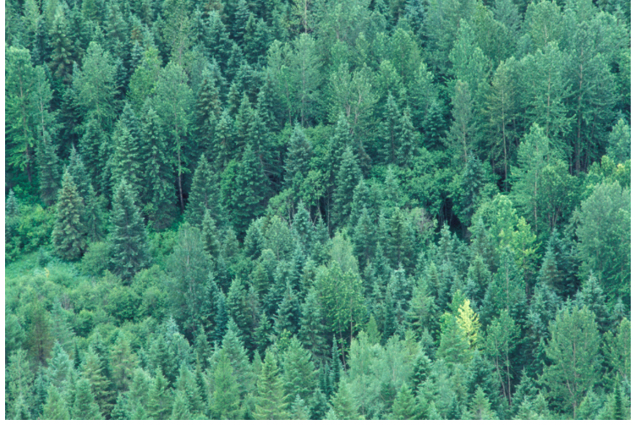

Slide 7
TERRIFIC…it’s a Forest!
Now we’re getting somewhere!

Slide 8
Now…where do you want the football to end up?

Slide 9
It’s a forest?…
This is getting confusing…

Slide 10
Hold on a minute…what’s this?

Slide 11
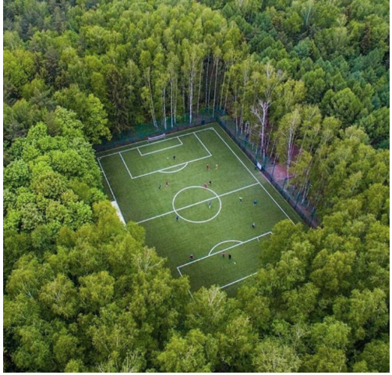

Slide 12
AHA!...
Now where do you want the football to go?

Slide 13
Where do you really want the football to end up?

Slide 14
In the net of course!
So, imagine that the football is your product or service and the net is your target…

Slide 15
You cannot hit a target that you do not have…

Slide 16
Introducing…
Market Segmentation and Target Marketing

Slide 17
Objectives
Students should be able to:
    Understand the basic concepts of Segmentation
    Definition of Segmentation
    Advantages and disadvantages of Segmentation
    Process of Segmentation
    Segmentation Criteria
    Understand Target Marketing and Positioning

Slide 18
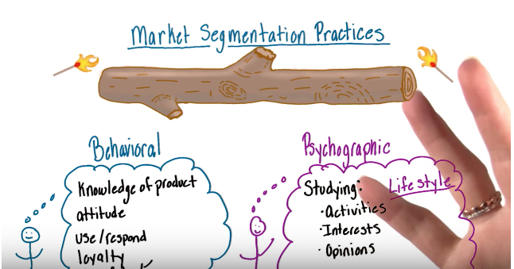
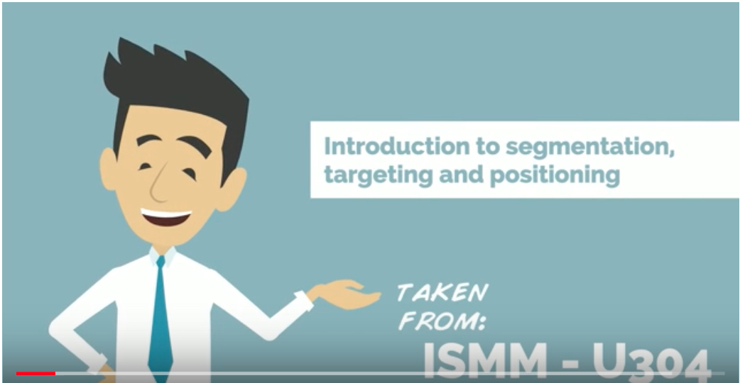
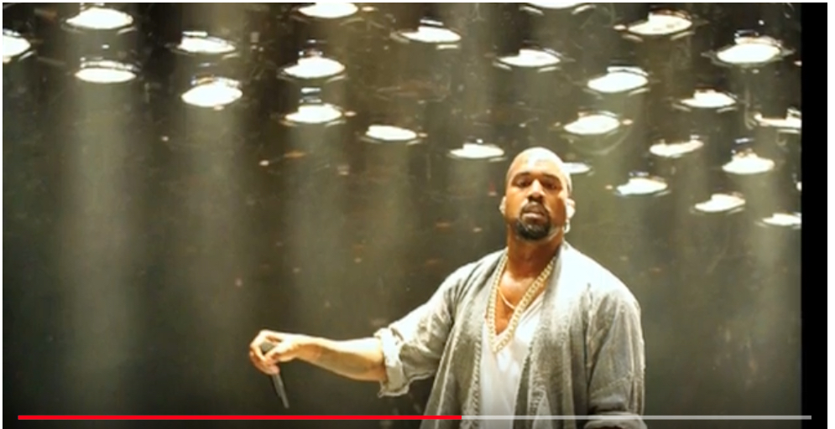
Market Segmentation – 3 Short Videos
1
2
https://www.youtube.com/watch?v=zumYa-gC0BI
3
https://www.youtube.com/watch?v=MEXmmHtKQzQ
https://www.youtube.com/watch?v=RpajdZFENOg

Slide 19
Market Segmentation
Definition

Slide 20
Market Segmentation
“Dividing a market into distinct groups of buyers,
who have needs, characteristics and behaviour and who might require separate products or marketing mixes”
Kotler & Armstrong

Slide 21
Why is it relevant?
As the old saying goes…
…“You can’t please all of the people all of the time!
In Marketing…
You have to aim the right products at the right people,
at the right price and in the right place,
…in order to achieve sales success.

Slide 22

It’s a bit like identifying and matching up…
For example…here’s a picture of a typical Xbox customer…

Slide 23
No?...

Slide 24
Why not?
Have a quick discussion about… who is
the typical customer for Xbox?

Slide 25
Things to consider?
Try to identify as many factors as you can about potential customers, for example:
Age range
Gender
Family size
Location
Income
Occupation
Education
Religion
Race
Nationality
Social classification or personal characteristics

Slide 26
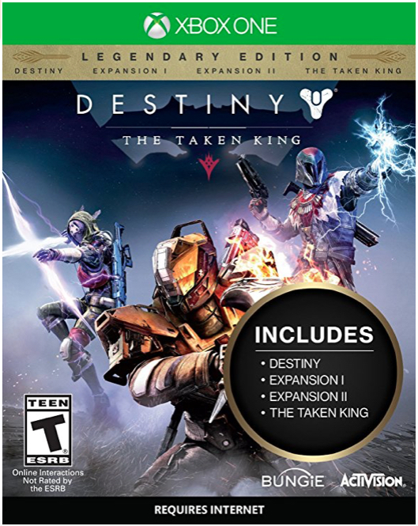
Typical Customer for Destiny?

Slide 27
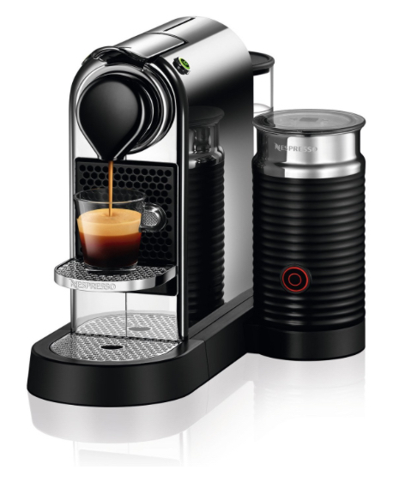
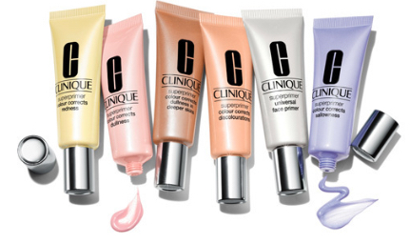
Who are the customers for these products?

Slide 28
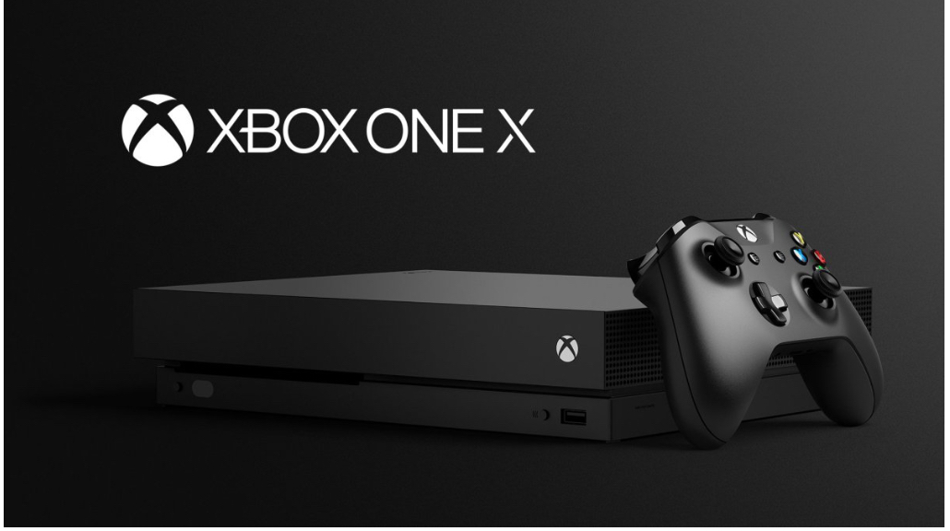
…and this one?

Slide 29
What is a segment?
What product design and functions would be included.
What imagery, language or terms would you use in trying to appeal to:
Golfers
Beat headphones users
Over 55’s – insurance, cruise holidays, double glazing, etc
Xbox users
Beauty Spa users
You need to know all you can about a particular audience.

Slide 30
Advantages and Disadvantages
of Segmentation

Slide 31
Advantages of Segmentation
Improves understanding of the customer base
Provides a clear classification of the customers
Enables the generation of a targeted product portfolio that responds to the needs of the market place
Helps gauge a company's market position relative to the competition
Leads to the effective fine tuning of marketing strategies and competitive advantage if done well

Slide 32
Disadvantages
When segmentation is NOT useful:
The market is so small that marketing to a portion of it is not profitable
Heavy users make such a large proportion of the sales volume that they are the only relevant target
The brand is the dominant brand in the market

Slide 33
The Process of Segmentation

Slide 34
Segmentation, Targeting and Positioning
Market Segmentation
Dividing the market into distinct groups of buyers with different needs, characteristics, and/or behaviour, who might require separate products or marketing mixes.
Market Targeting
The process of evaluating each market segment’s attractiveness and selecting one or more segments to enter.
Product Positioning
Ensuring a product occupies a distinctive and desirable place relative to competing products in the mind of target comsumers. Formulating competitive positioning for a product and creating a detailed marketing mix.

Slide 35
Segmentation, Targeting and Positioning
Identify bases for segmenting market
Market
Segmentation
Develop profiles of resulting segments
Develop measures of segment attractiveness
Market
targeting
Select the target segment(s)
Develop positioning for each segment
Market
positioning
Develop marketing mix for each segment

Slide 36
Segmentation Variables
Marketers have traditionally used three categories of variables to identify market segments –
Geographic segmentation – dividing a market into different geographical units such as nations, states, regions, counties, cities or neighbourhoods
Demographic segmentation – dividing the market into groups, such as age, gender, family size, income, education, religion, or ethnicity
Psychographic segmentation – variables, such as social class, personality, or their approach to life

Slide 37
Group Task
Choose a product or service and provide a slide presentation showing market segmentation and target market.
Consider the following:
Geographic segmentation – dividing a market into different geographical units such as nations, states, regions, counties, cities or neighbourhoods
Demographic segmentation – dividing the market into groups, such as age, gender, family size, income, education, religion, or ethnicity
Psychographic segmentation – variables, such as social class, personality, or their approach to life

